Slide 1
Project Final Presentation
Movie Recommendation Application
Team 1
Chenjie Jiang(Sabrina)
Chen Liang(Max)
Yu Liu
Sushma Tayanna

Slide 2
Functions Introduction
Movie Recommendation Sys.
Login/Register Module
Searching Module
Details
Module
Movie Recommend
Module
Guest
Recommendation
User
Recommendation
Based on
Average Rating
Based on
Searching History

Slide 3
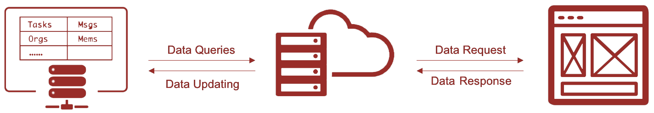
Technological Framework
Database
Backend Server
Frontend
MySQL
Python+Flask
JavaScript+jQuery+Ajax

Slide 4
Database
Users
UserID
Username
Password
Movies | Ratings | Links
MovieID | MovieID | MovieID
Title | RateUserID | imdbID
Year | Rating | tmdbID
Genres | Timestamp
Search_History
UserID
MovieID

Slide 5
Data Flow
{Title: 'abc',
Genres: 'action',
Years:'1990-1999',
Rating:'4.0-5.0’}
title = abc
genres = action
min_years = 1990
max_years = 1999
min_rating = 4.0
max_ratings = 5.0
title LIKE '%abc%';
genres = 'action';
years >= 1990
AND years <= 1999;
rating >= 1990
AND rating <= 5.0;
User/Frontend
Backend Server
Database
Request Data
Returned Data
Requesting Data

Slide 6
Data Flow
Session = a05c9a3c4f441eb9b49c163d1e9036a4
mId = 1
userId = 1
mId = 1
INSERT INTO HISTORY_SEARCH
…
User/Frontend
Backend Server
Database
Request Data
Inserting Data

Slide 7
A View for Database
MovieID | RateUserID | Rating | TimeStamp
17 | 22 | 4.0 | 1275494533
17 | 23 | 3.0 | 1274358294
17 | 24 | 3.5 | 1275435289
17 | 25 | 2.5 | 1274538952
MovieID | RateUserID | Rating | TimeStamp
17 | 22 | 4.0 | 1275494533
4.0
MID | Avg_Rating
17 | 3.25…
17 | 23 | 3.0 | 1274358294
3.0
17 | 24 | 3.5 | 1275435289
3.5
17 | 25 | 2.5 | 1274538952
2.5
Original Rating Table
The view
Create a View for Average Rating

Slide 8
Cache Mechanism
IMDB Server
Fetch Image
(imdbID)
User/Webpage
Image Request
Backend Server
Cache Image
Cache Hit
Backend Server
File System
Process of Cache Mechanism

Slide 9
Query Optimization
Before Optimization
Advantages
select * from movies where year = 1990
Reducing the cost of transiting the data on the network
Reducing the cost of data processing
Reducing the memory required for the client
After Optimization
select title from movies where year = 1990

Slide 10

Demo
Link to the Website

Slide 11
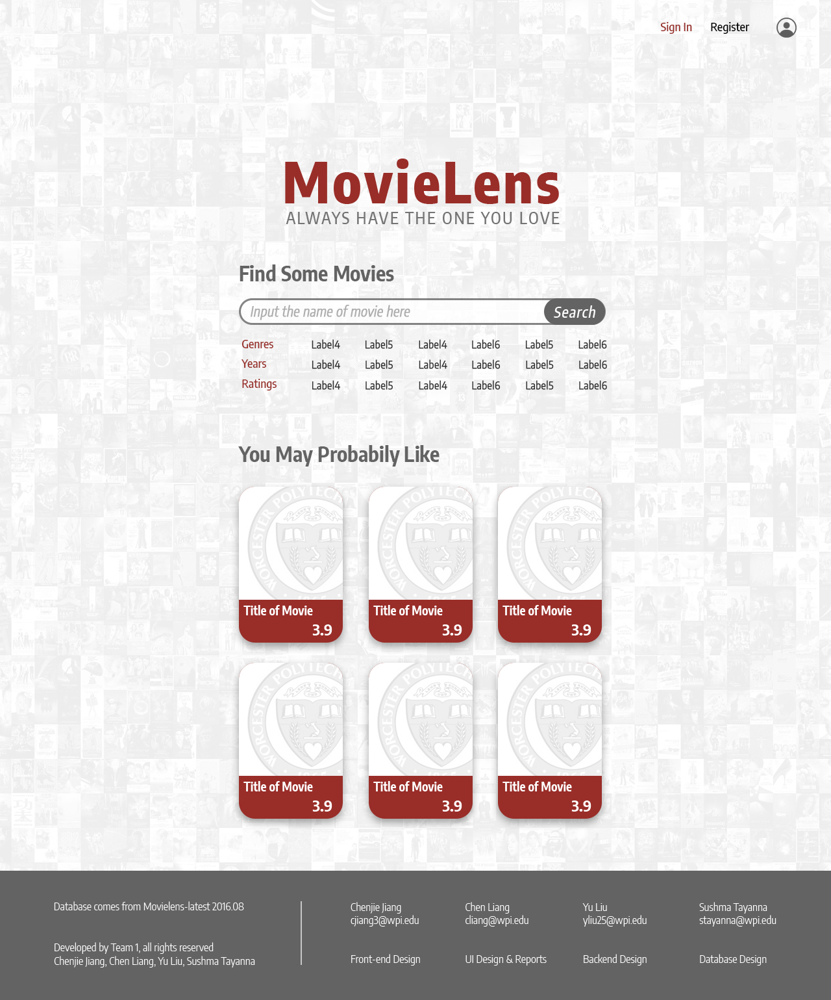
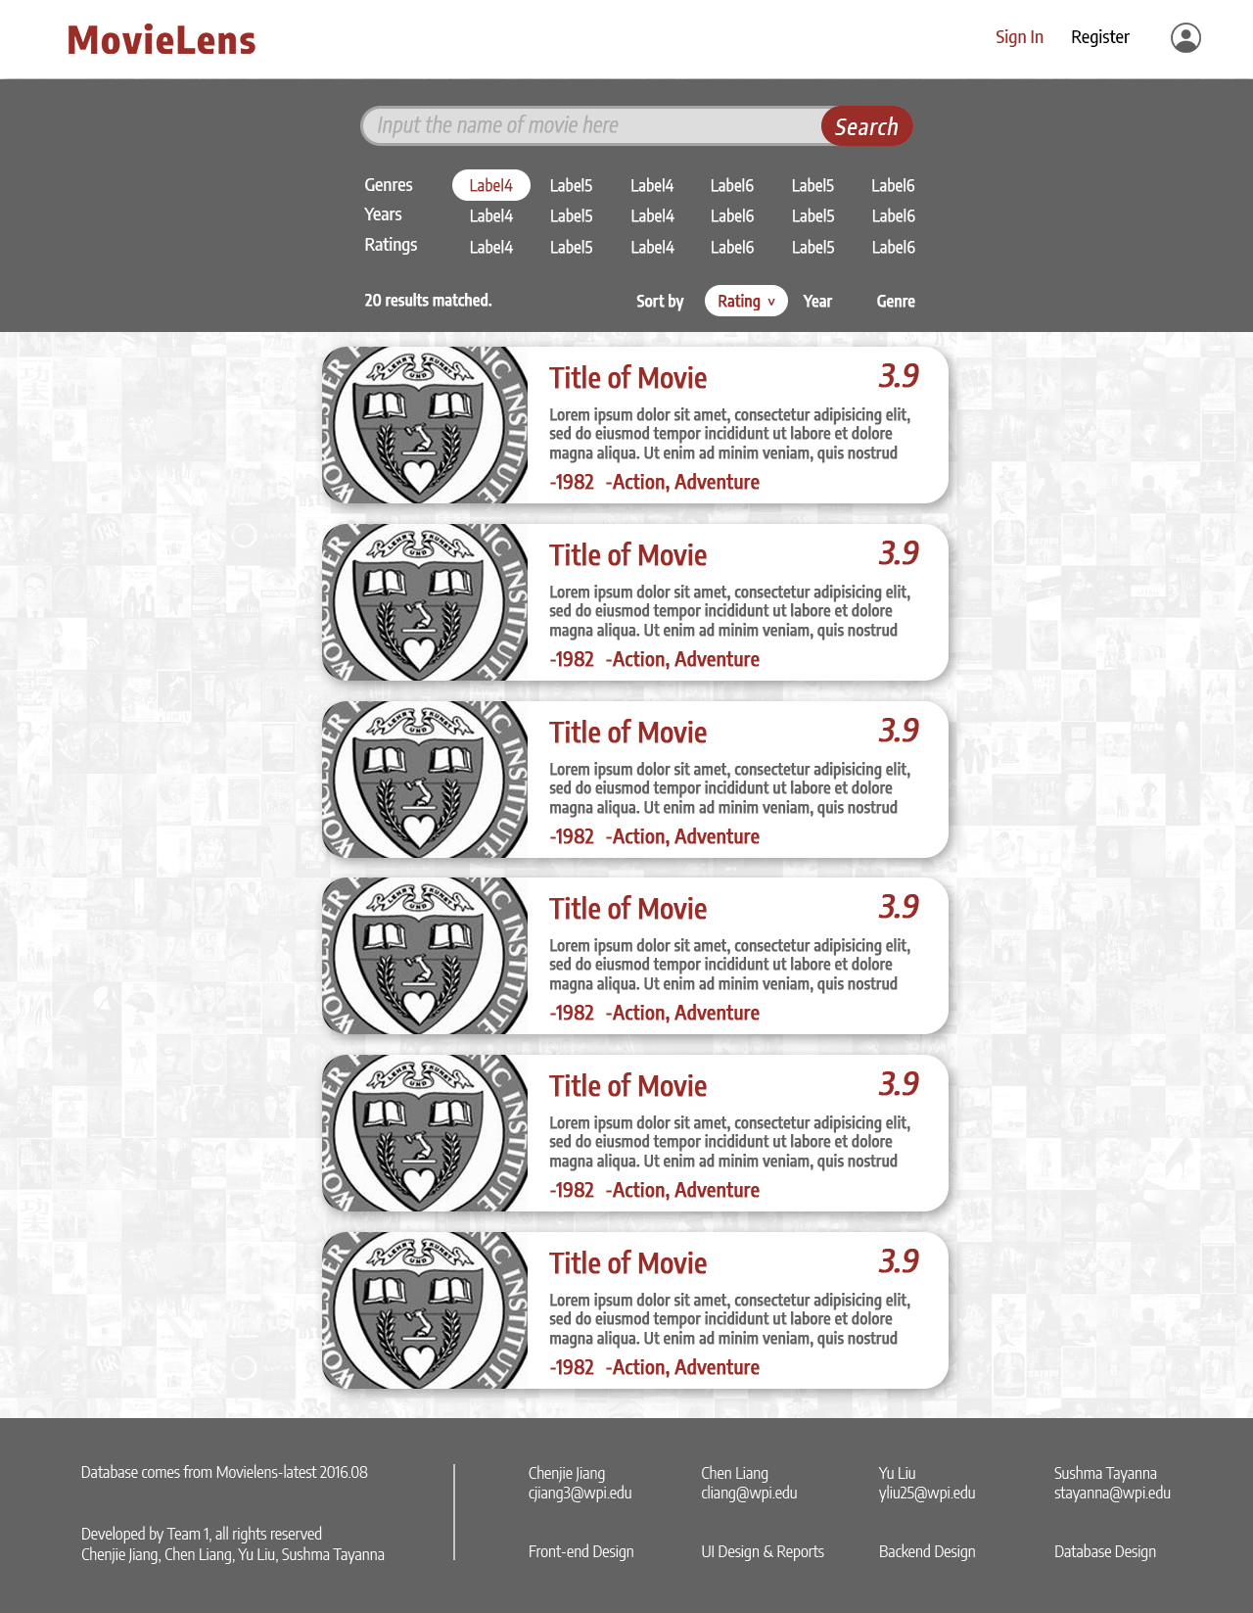
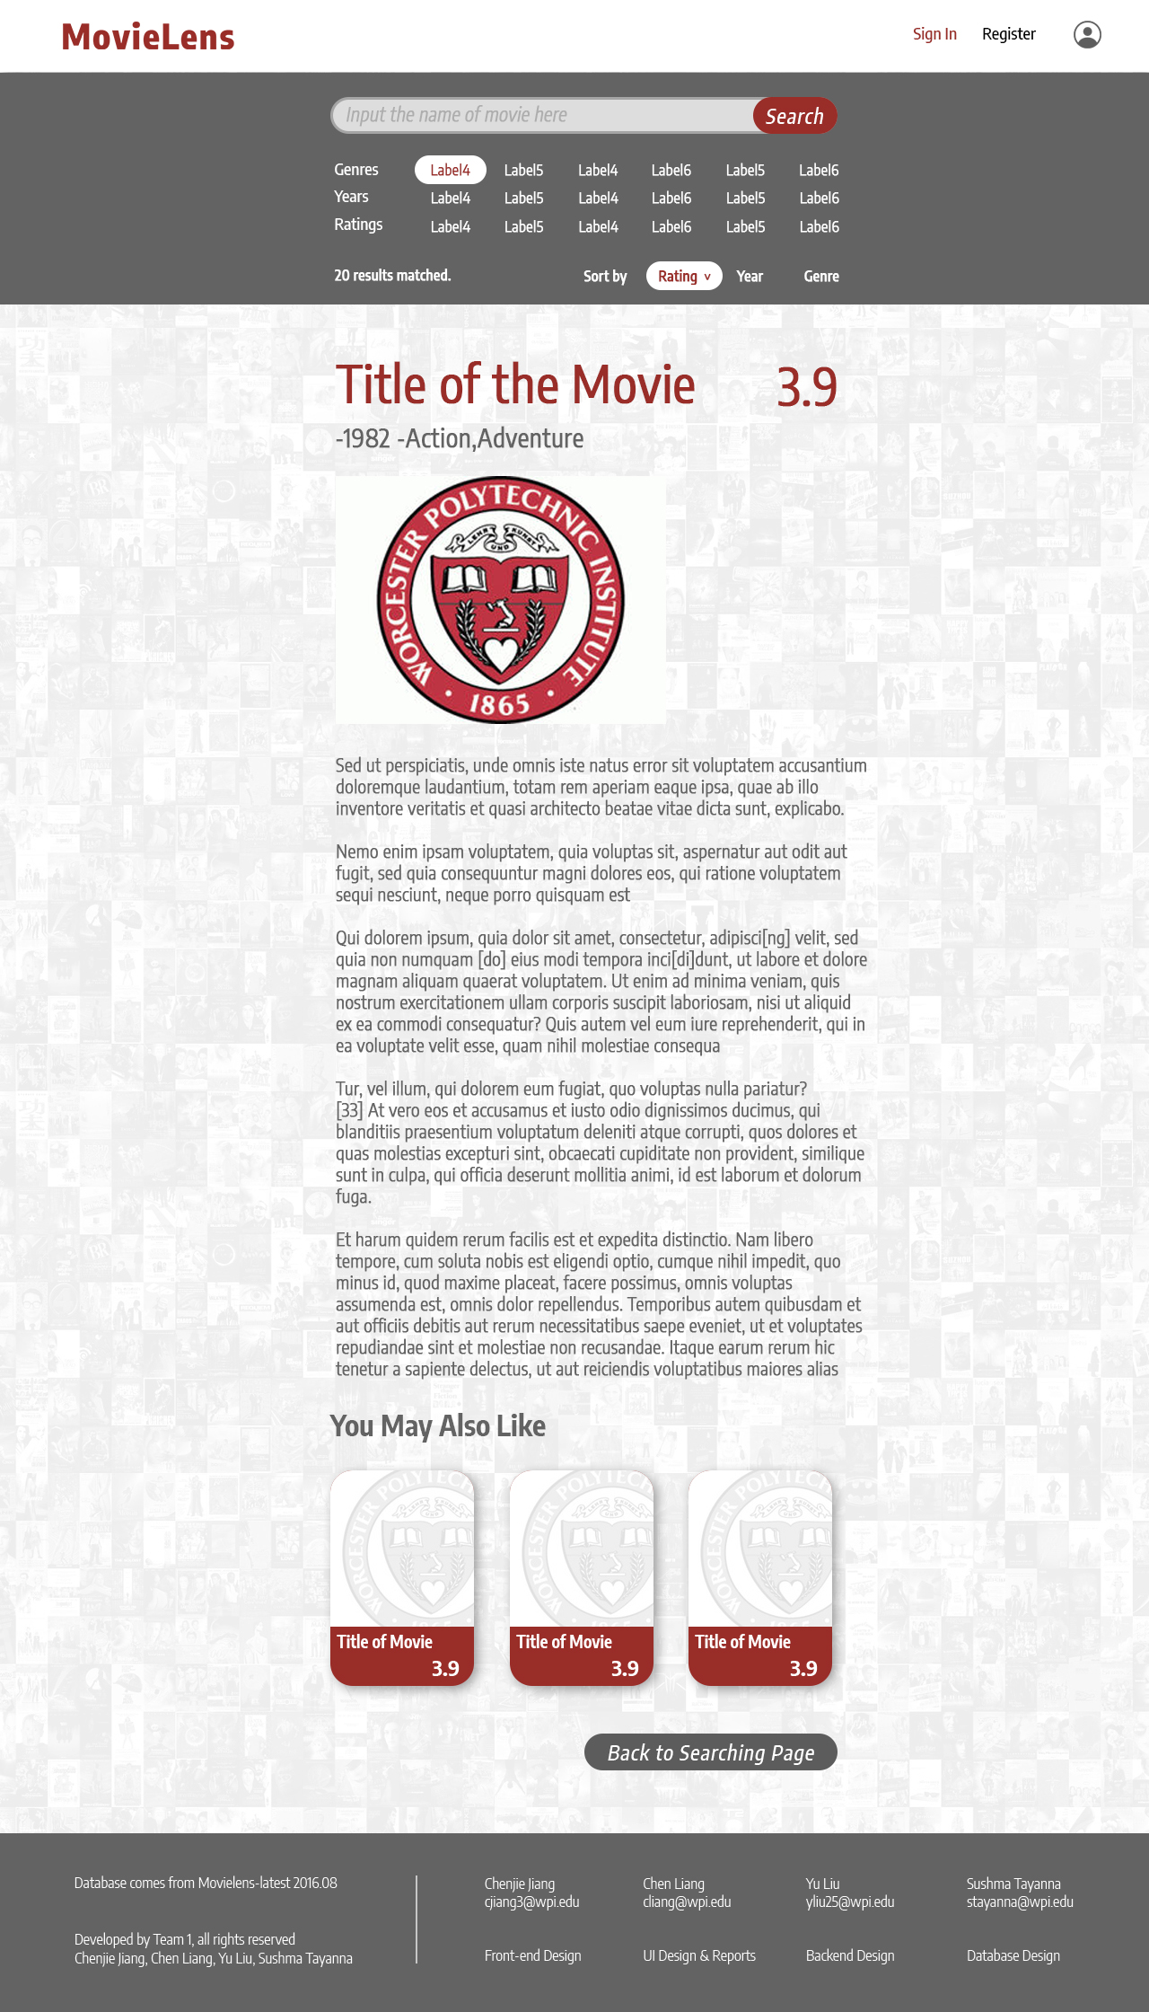
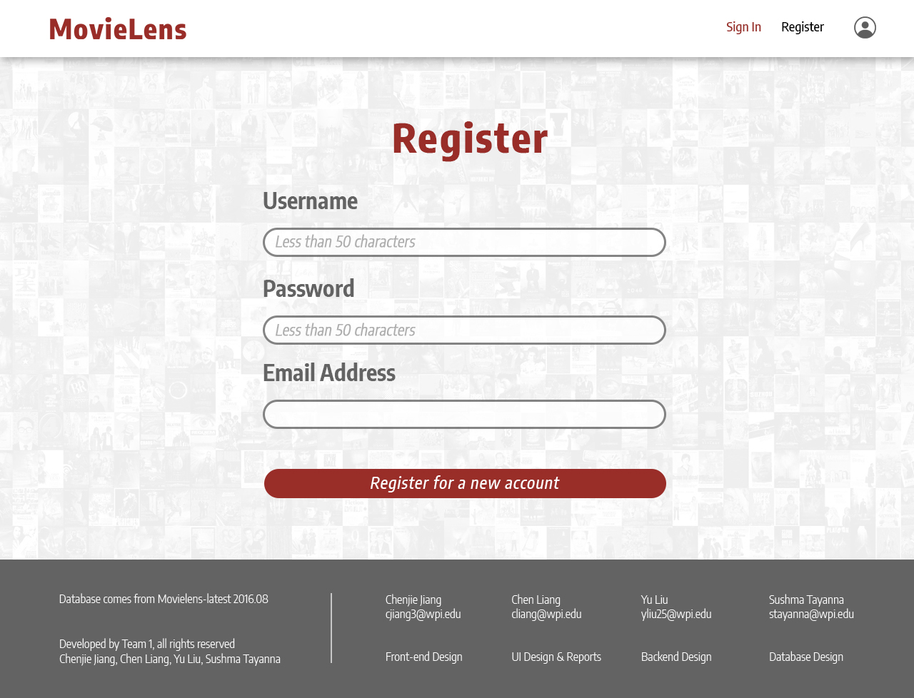
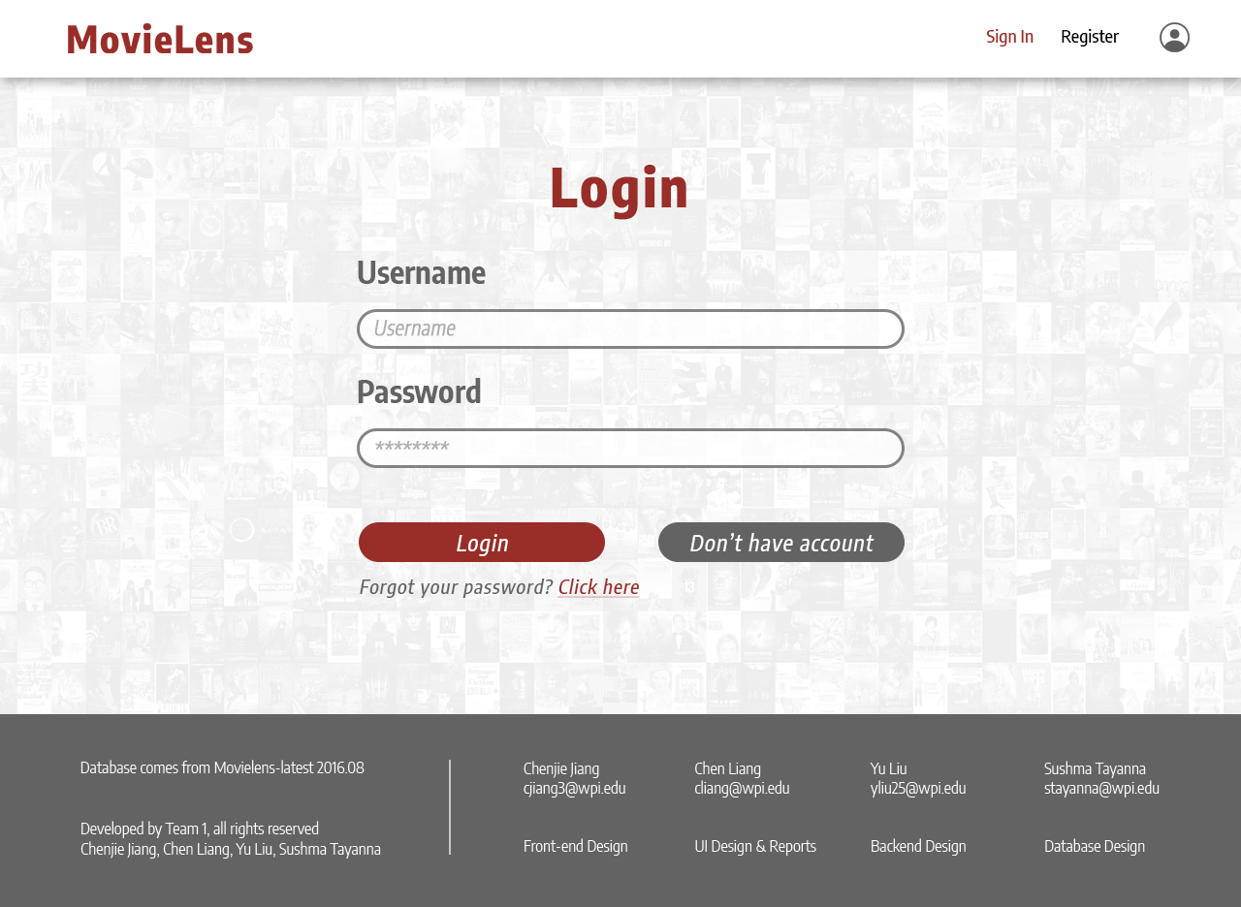
UI Diagram & Collaboration
Chenjie Jiang
User Interface Data Flow(Event handler, Data request, Data rendering)
Yu Liu
Backend Design (Database connection, Interfaces Design)
Chen Liang
UI Design and CSS Design
Sushma Tayanna
Database Design

Slide 12
Q&A
Thanks for Watching

